Slide 1

Cleaner Business Rules With Json Rules Engine and Azure Functions
Mandar Dharmadhikari

Slide 2





Who am I?
Manager at Accenture
Azure and Power Platform Architect and Developer
Agile and Continuous Delivery enthusiast
codidharma
@codidharma
mandar-dharmadhikari
https://codidharma.com

Slide 3



Business Scenario
Anita
Age: 65
Wants to buy a fixed deposit for 6 months
Provides
Senior Citizen Rate of 4.5 %
Good Banking Corp Ltd
Raj
Age: 35
Wants to buy a fixed deposit for 7 months
Provides
Regular Citizen Rate of 4.3 %
Good Banking Corp Ltd

Slide 4
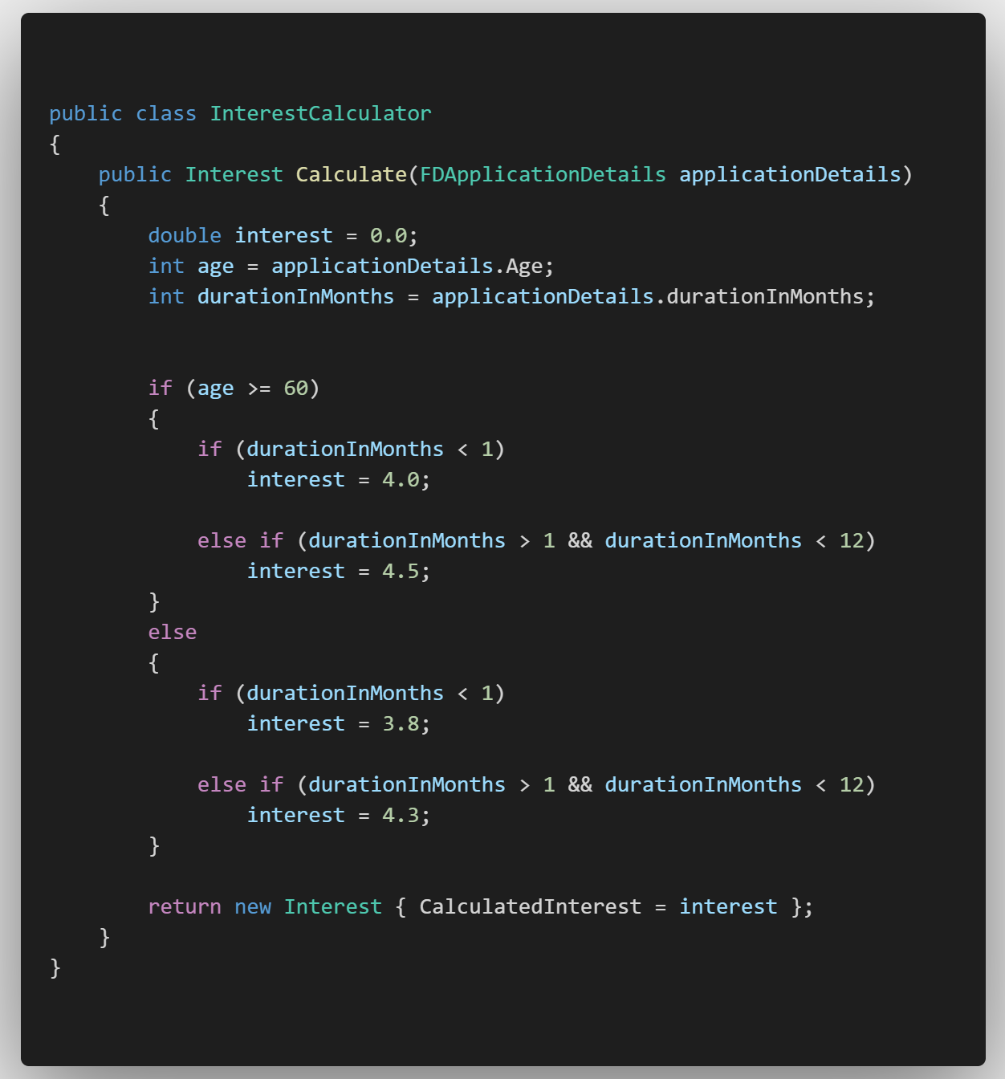
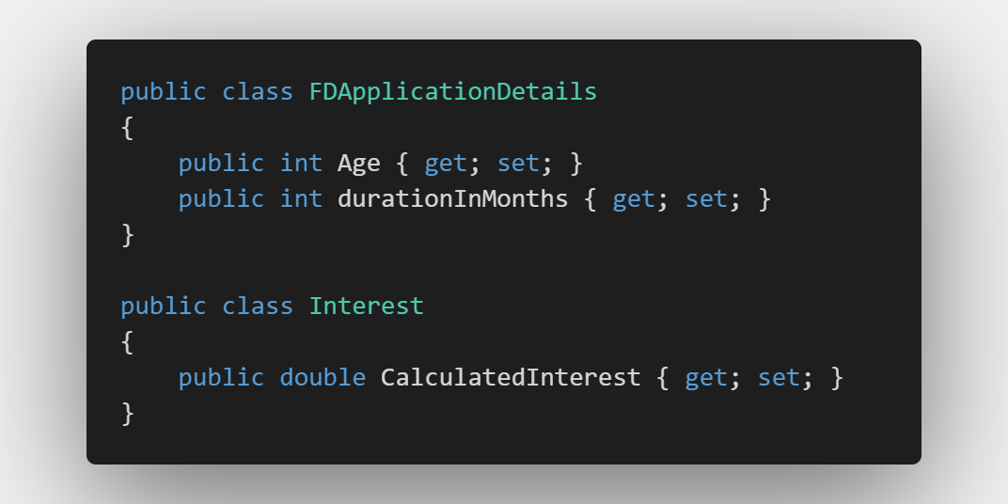
Traditional way of adding business rules to System

Slide 5
What are the Cons of This Approach?
Tight coupling between the rules and the service
Difficult to maintain if number of rules increase
Deployment needed every time a rule changes

Slide 6
Rules Engine To Rescue
A rules engine is all about providing an alternative computational model. Instead of the usual imperative model, which consists of commands in sequence with conditionals and loops, a rules engine is based on a Production Rule System. This is a set of production rules, each of which has a condition and an action - simplistically you can think of it as a bunch of if-then statements
- Martin Fowler (RulesEngine (martinfowler.com))

Slide 7
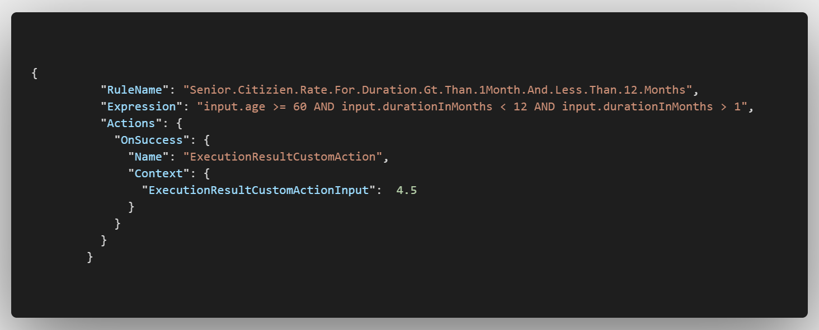
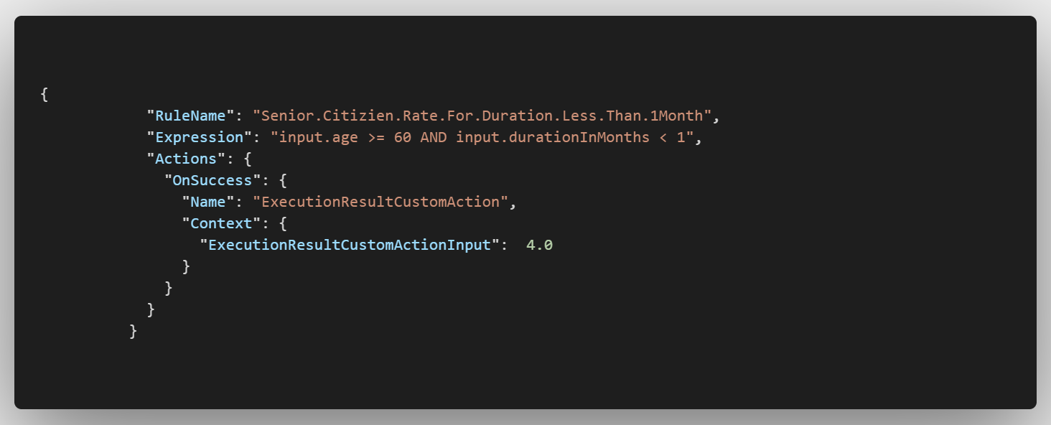
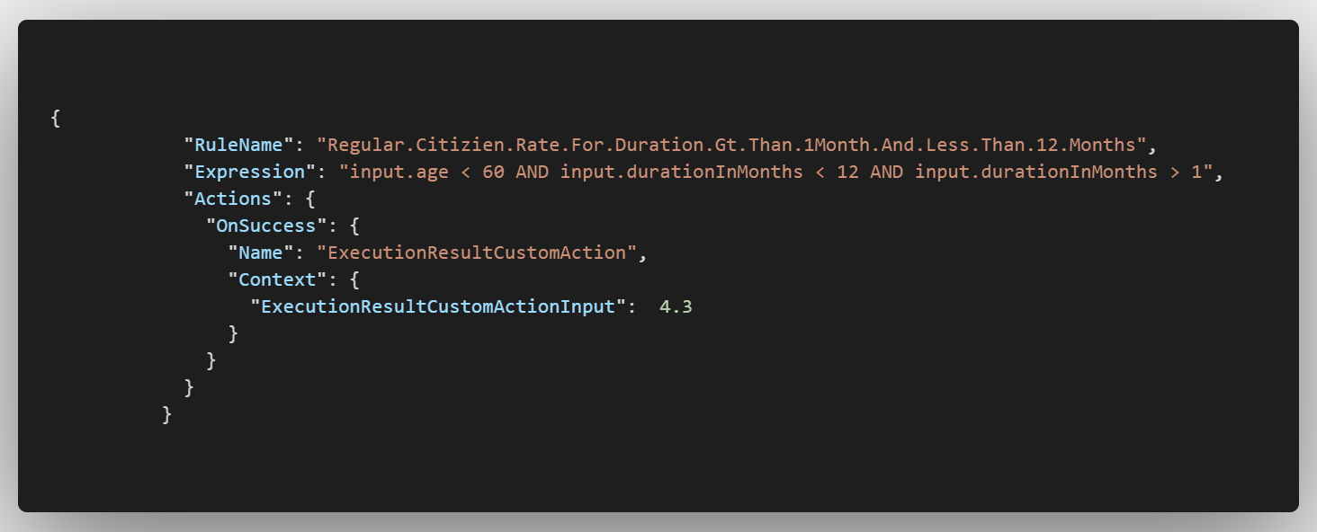
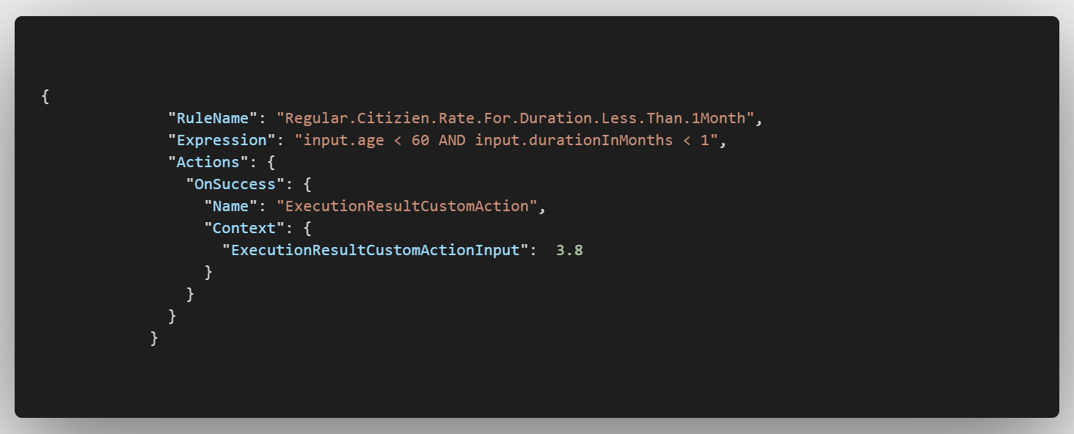
Business Rules Reimplemented

Slide 8
Rules Engine To The Rescue
De couples the rules and the service implementation
Easier to maintain as the rules are externalized and stored in the rules store
Every change requires a deployment of simple rules file
Cleaner way to implement rules

Slide 9






How This Looks in Azure???
Rules Store- Blob Container
Orchestrators
Web Apps
Mobile Apps
Serverless Stateless Functions Wrapper
Rules Engine Black Box

Slide 10

Json Rules Engine
Open Source Engine supported by Microsoft
Easy to integrate due to the black box nature of the engine
Supports writing rules using lightweight JSON format
Strong support for Behavior Driven Development

Slide 11
Azure Functions
Serverless Compute Service
Has plethora of triggers and bindings to integrate with various Azure Services
Developer Oriented
Supports Local Debugging and Testing
Supports containerizations and production slots
Can be run on fixed price App Service Plans or Consumption Based plans

Slide 12
Blob Storage
Microsoft’s object storage solution for the cloud
Optimized to store massive amount of structured data
Built for scale
Ideal for serving images, videos, static webpages etc

Slide 13
Demo Time

Slide 14
Cons of Rules Engine?
Has some learning curve to understand the system.
Decoupling is not always good, needs a careful evaluation of the complexity of the system being built
Should be used when a use case warrants
Notes:
Since the rules engine employs a different paradigm of rules authoring than structred if else statements, it tales some time to understand what is the optimum way of writing rules
Decoupling of rules from the service introduces the learning curve, but the rules engine needs to be used based on the use case and the resulting complexity from it.
In my opinion, simple systems can get by without a rules engine but more business rules heavy system will surely benefit from the advantages offered by the Rules engine

Slide 15
Thank You !!!
Notes:
Since the rules engine employs a different paradigm of rules authoring than structred if else statements, it tales some time to understand what is the optimum way of writing rules
Decoupling of rules from the service introduces the learning curve, but the rules engine needs to be used based on the use case and the resulting complexity from it.
In my opinion, simple systems can get by without a rules engine but more business rules heavy system will surely benefit from the advantages offered by the Rules engine

